Slide 1
Ruby
Keith Gable
Script Programming w/ Ted Ward
OSU-Okmulgee

Slide 2
History
Ruby was started in 1993 and first released in 1995
It was written by a Japanese-speaking man named Yukihiro "Matz" Matsumoto
The name Ruby comes from a joke making fun of Perl
There are Ruby interpreters for a number of platforms, including native, Java, .NET, and Smalltalk
Ruby is widely used. Notable uses include
37Signals' Basecamp and the Ruby on Rails web application framework.

Slide 3
Sample Code
5.times { print “Hello” }
ks_movies = [“Dogma”, “Mallrats”, “Clerks”, “Clerks 2”]
ks_movies.each do |ks_movie|
print ks_movie
end
The above code:
Prints Hello 5 times
Creates an array containing some Kevin Smith movies
Prints each movie out
Execute in UNIX the standard way. Either have a shebang and ./file.rb (chmod +x first) or ruby file.rb

Slide 4
Strengths
Ruby's main strength is that it is designed to read almost exactly like plain English. In the previous example, “Five times print hello” does that exactly. In the loop statement, it is read “Print each ks_movie in ks_movies.”
The “each” function is Ruby's main loop structure. There is no for loop.
Additionally, in Ruby, everything is a class. Everything. The literal string “Python Sucks” is an instance of a class and can be operated on. For example, “Python Sucks”.gsub(“Python”, “Microsoft”) will return “Microsoft Sucks.”
Ruby is also a good cross-platform replacement for BASIC due to its ease of use.

Slide 5
Weaknesses
Ruby does not have a byte compiler like .NET or Python. Instead, scripts and applications are loaded into the “Ruby Virtual Machine” and run there, where the native machine code is Ruby. The Ruby VM has been rewritten in Ruby 2.0 and is 50% faster. The main difference between Ruby and .NET or Python in this regard is that applications and scripts take longer to load into the interpreter.

Slide 6
Supported Platforms
Windows
Linux
UNIX
MacOS X
Java
.NET

Slide 7
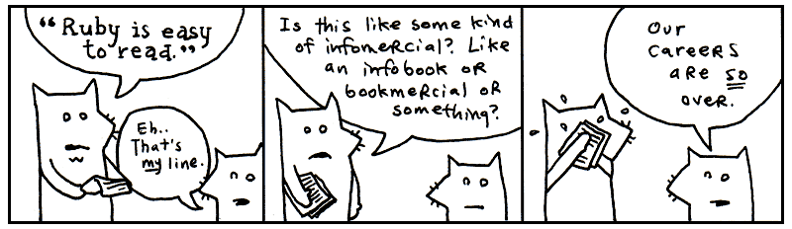
Learning Ruby
Learning Ruby is not very hard to people that speak English. With that in mind, there are two major ways a person can learn to code in Ruby:
why's (poignant) guide to ruby
http://poignantguide.net/ruby/
This book is unlike any programming book. Cartoon
foxes, fanciful stories, and other craziness are all over
this book. So it's a fun read for
anyone with any level of
programming ability
(or none at all).
Programming Ruby: The Pragmatic Programmer's Guide
http://amazon.com/o/ASIN/0974514055/
This book is geared towards programmers who can't
stand cartoon foxes.

Slide 8
Personal Opinions
Coming from Visual Basic, Ruby is a lot easier and infinitely more powerful. There are loads of advanced features available, including embedding C code directly into your Ruby source code. Additionally, the Ruby on Rails web application framework is awesome and speeds up the development of a web application a hundred times. It is a good all-around language that does most things really well. For simpler tasks, Bash scripting may be better.

